Slide 1
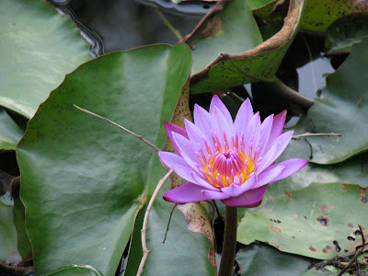
Water Lily: The National Flower of Bangladesh
The water lily (Nymphaea nuchal) is the national flower of Bangladesh. Nymphaea nuchal is considered a medicinal plant in Indian Ayurveda medicine under the name ambal; it was mainly used to treat indigestion. Recent experiments have confirmed that it has medicinal qualities as an ant hepatotoxic and antidiabetic.

Slide 2
Characteristics
The white water lily is recognized by its large, floating, circular leaves and large, white flowers.
The waxy leaves are up to 8 inches across with a narrow v-shaped cleft where the stem attaches.
The underside of the leaf is green or reddish-purple in color.

Slide 3
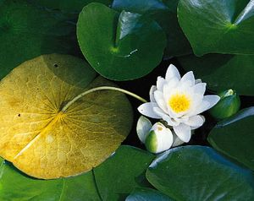
Physical description
Most species of water lilies have rounded and variously notched waxy-coated leaves on long stalks that contain many air spaces and float in quiet freshwater habitats. The stalks arise from thick fleshy creeping underwater stems that are buried in the mud. The showy fragrant solitary flowers are borne at or above the water surface on long stalks that are attached to the underground stems.

Slide 4
Uses
The starchy rootstocks (rhizomes) of the sacred lotus are eaten extensively in China, Japan, India, and other Asian countries. They are sold fresh and often whole and are available frozen or canned. They are the source of the starch known as lotus meal. The rhizomes are common in soups and curries and are also fried or stuffed with meats, or they can be boiled or preserved.

Slide 5
Thank You
For more details Khadija Sultana.pptx

